Slide 1



Spring MVC
Building web apps
Mar 2022

Slide 2




Luis Cortes
Java Architect
@luis.cortes

Slide 3
Index
1.
5.
Servlet API
View resolvers
2.
6.
Spring MVC Architecture
Themes, internationalization, and views
3.
Web Application Context
4.
Basic Configuration
‹#›
Globant proprietary | Confidential information

Slide 4
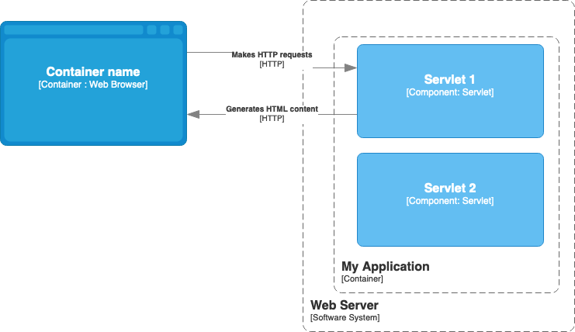
Spring MVC
Java Web Applications
Servlet API
1
Defined as part of Java Web Specification.
2
“A servlet is a Java programming language class used to extend the capabilities of servers that host applications accessed by means of a request-response programming model” [2]
3
It defines a lifecycle (loads the class, creates an instance, init, service, destroy)
4
Defines a mechanism to share information among servlets by using the concept of scopes (Web context, session, request, page)

Slide 5
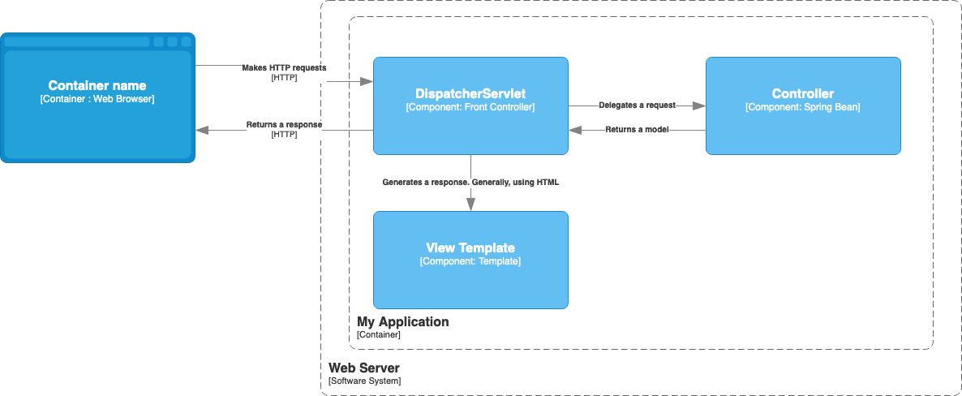
Spring MVC
Java Web Applications
Spring MVC
1
“Spring Web MVC is the original web framework built on the Servlet API and has been included in the Spring Framework from the very beginning” [1]
2
“The formal name, “Spring Web MVC,” comes from the name of its source module (spring-webmvc), but it is more commonly known as “Spring MVC””[1]

Slide 6
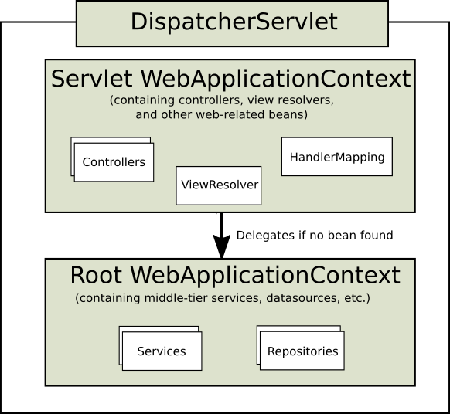
Spring MVC
Web Context
Web Application Context
1
WebApplicationContext expects an ApplicationContext object that references a ServletContext and its Servlet associated with.
2
Root WebApplicationContext is shared across multiple DispatcherServlet instances and even other Servlet objects. It contains infrastructure beans (services, repositories)

Slide 7



Spring MVC
Bean Types
HandlerMapping: Map a request to a handler along with a list of interceptors for pre- and post-processing. RequestMappingHandlerMapping is a common implementation. That supports @RequestMapping annotated methods.
HandlerExceptionResolver: Strategy to resolve exceptions, possibly mapping them to handlers, to HTML error views, or other targets
LocaleResolver, LocaleContextResolver: Resolve the Locale a client is using and possibly their time zone, in order to be able to offer internationalized views
ViewResolver: Resolve logical String-based view names returned from a handler to an actual View with which to render to the response.
ThemeResolver: Resolve themes your web application can use
HandlerAdapter: Help the DispatcherServlet to invoke a handler mapped to a request, regardless of how the handler is actually invoked.
‹#›
Globant proprietary | Confidential information
Propiedad Globant | Información Confidencial
Notes:
Globant's Salesforce Studio maximizes your investment in the Salesforce Customer 360 Platform, solving our client's increasingly challenging customers’ and employees’ needs, co-creating a roadmap of digital solutions to stay ahead of market changes.
We enable our clients with Augmented Sales & Customer Service, Marketing and e-Commerce Processes, fueled by our AI Accelerators, with an Enterprise Customer Data Architecture integrating core business applications using Mulesoft and Informatica Cloud Solutions among others.
Our proven experience with Salesforce Industry Solutions facilitates our clients' transformation from a product-centric to a customer-centric organization.
We help organizations potentialize Salesforce.com continuously improving end-user adoption, creating and deploying departmental apps, seamlessly integrating multi-cloud environments to achieve a better return on their Salesforce.com investment.
We enhance our Salesforce Strategy, Implementation, and Continuous Transformation Services with Globant´s deep expertise in DevSecOps & Continuous Delivery, DataOps, Enterprise Agile Frameworks, Human Centric Design, and Design Thinking, providing a deep and comprehensive solution to our clients' needs.

Slide 8
Spring MVC
Bean Types
MultipartResolver: Abstraction for parsing a multi-part request
FlashMapManager: Store and retrieve the “input” and the “output” FlashMap that can be used to pass attributes from one request to another, usually across a redirect
‹#›
Globant proprietary | Confidential information
Propiedad Globant | Información Confidencial
Notes:
Globant's Salesforce Studio maximizes your investment in the Salesforce Customer 360 Platform, solving our client's increasingly challenging customers’ and employees’ needs, co-creating a roadmap of digital solutions to stay ahead of market changes.
We enable our clients with Augmented Sales & Customer Service, Marketing and e-Commerce Processes, fueled by our AI Accelerators, with an Enterprise Customer Data Architecture integrating core business applications using Mulesoft and Informatica Cloud Solutions among others.
Our proven experience with Salesforce Industry Solutions facilitates our clients' transformation from a product-centric to a customer-centric organization.
We help organizations potentialize Salesforce.com continuously improving end-user adoption, creating and deploying departmental apps, seamlessly integrating multi-cloud environments to achieve a better return on their Salesforce.com investment.
We enhance our Salesforce Strategy, Implementation, and Continuous Transformation Services with Globant´s deep expertise in DevSecOps & Continuous Delivery, DataOps, Enterprise Agile Frameworks, Human Centric Design, and Design Thinking, providing a deep and comprehensive solution to our clients' needs.

Slide 9
Spring MVC
Basic Configuration
1
Creates a Servlet Config programmatically or by creating a web.xml file
2
Creates a WebApplicationInitializer to create root and web application contexts

Slide 10
Spring MVC
View resolvers
1
3
Handling: it allows the ViewResolver chaining like using Jackson, UrlBasedViewResolver, and Thymeleaf at the same time
Fordwarding: Defines forward: prefix to let the UrlBasedViewResolver and subclasses handle the request. It does not work using InternalResourceViewResolver
2
4
Redirecting: Defines redirect: prefix to redirect a request to an specific view (“redirect:home”)
Content negotiation: It does not resolve views, it delegates to other view resolvers instead. Selects the view to present, for example getting it from a header or from a request param (/path?format=pdf)

Slide 11
Spring MVC
Themes, internationalization, and views
Themes: You can apply Spring Web MVC framework themes to set the overall look-and-feel of your application. It’s possible to resolve a theme by using its name, setting up a cookie , or keeping it in the session.
View technologies: It works as a plugin, so you will be able to choose one of the options like Thymeleaf, Freemaker, JSPs, among others.
Internationalization: It resolves messages by using the user locale’s. It provides TimeZone, header, cookie, session, and locale resolvers.
‹#›
Globant proprietary | Confidential information
Propiedad Globant | Información Confidencial
Notes:
Globant's Salesforce Studio maximizes your investment in the Salesforce Customer 360 Platform, solving our client's increasingly challenging customers’ and employees’ needs, co-creating a roadmap of digital solutions to stay ahead of market changes.
We enable our clients with Augmented Sales & Customer Service, Marketing and e-Commerce Processes, fueled by our AI Accelerators, with an Enterprise Customer Data Architecture integrating core business applications using Mulesoft and Informatica Cloud Solutions among others.
Our proven experience with Salesforce Industry Solutions facilitates our clients' transformation from a product-centric to a customer-centric organization.
We help organizations potentialize Salesforce.com continuously improving end-user adoption, creating and deploying departmental apps, seamlessly integrating multi-cloud environments to achieve a better return on their Salesforce.com investment.
We enhance our Salesforce Strategy, Implementation, and Continuous Transformation Services with Globant´s deep expertise in DevSecOps & Continuous Delivery, DataOps, Enterprise Agile Frameworks, Human Centric Design, and Design Thinking, providing a deep and comprehensive solution to our clients' needs.

Slide 12
References
[1]
Spring MVC Documentation
[2]
Java Servlet Documentation
[3]
Thymeleaf
‹#›
Globant proprietary | Confidential information

Slide 13

Thank you

